Slide 1
Designing a Wireless Sensor Network

Slide 2
What?
Wireless sensor network (WSN) refers to a group of sensors monitoring and recording the physical conditions of the environment and organizing the collected data at a central location.
You can measure temperature, sound, pollution levels, humidity, wind, and so on.But we have used Motion sensor only.

Slide 3
Requirements of our WSN:
1.Low Power consumption
2.Low form factor(Compact)
3.OTA update
4.Battey based
6.Rechargeable
5.Light weight

Slide 4
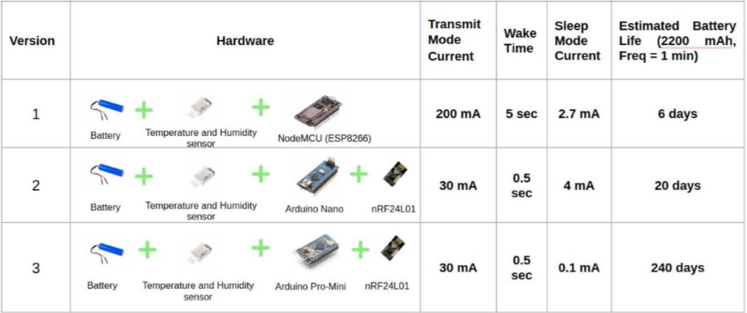
Sensor node features with components:

Slide 5
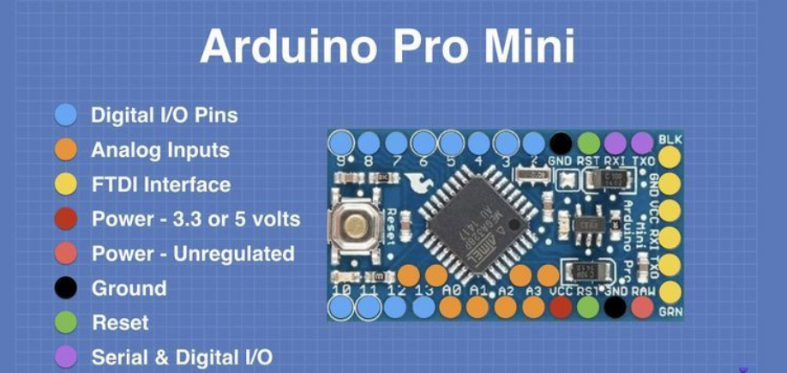
Specifications:
-Atmega 328 microcontroller
-Operating voltage 3.3-5V
-FTDI interface
-No inbuild WIFI
-Memory 32kilo Bytes

Slide 6
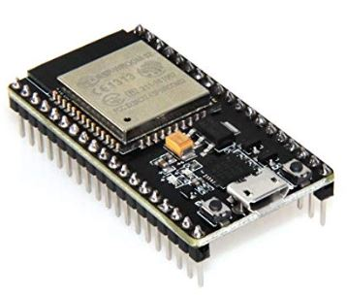
ESP32-WROOM-32 :
Features:
Robust Design
High Level of Integration
Ultra-Low Power Consumption
Hybrid Wi-Fi & Bluetooth Chip

Slide 7
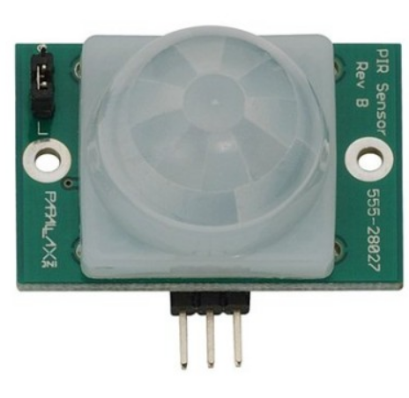
PIR Motion Sensor:
Specifications:
-Principle:Pyroelectric + IR
-Upto 6 meters
-Power supply :3.3-5V
-Output: Digital pulse high (3V) when triggered (motion detected) digital low when idle (no motion detected)

Slide 8
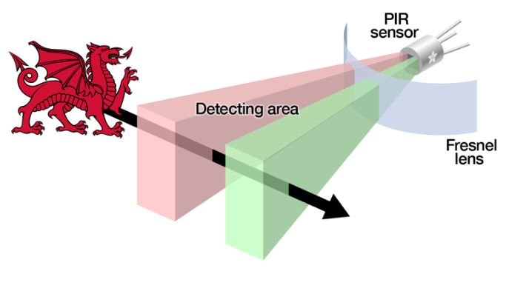
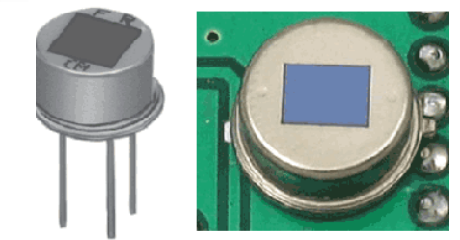
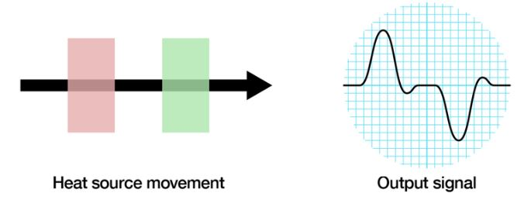
PIR principle:

Slide 9
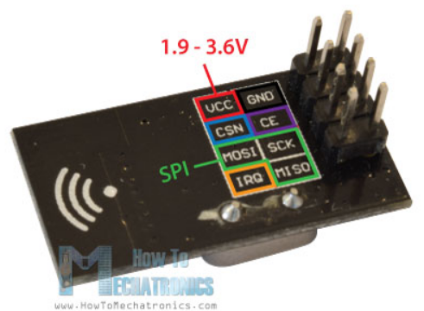
NRF Transreceiver
Specifications:
-2.4GHz transceiver
-Ultra low power operation
-250kbps, 1Mbps and 2Mbps on air data
rates
-1.9 to 3.6V supply range
-On chip voltage regulator
-SPI protocol

Slide 10
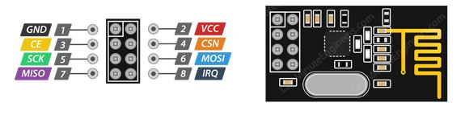
Nrf24L01 transreceiver:
Specifications:
-2.4GHz transceiver
-Ultra low power operation
-250kbps, 1Mbps and 2Mbps on air data
rates
-1.9 to 3.6V supply range
-On chip voltage regulator
-SPI protocol

Slide 11
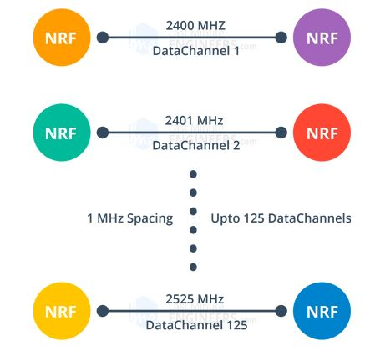
Nrf24L01 features and working:
What is 2.4 (2400 to 2525 MHz) GHz ISM band?
2.4 GHz band is one of the Industrial, Scientific, and Medical (ISM) bands reserved internationally for the use of unlicensed low-powered devices.
SPI Interface !
All the parameters such as frequency channel (125 selectable channels), output power (0 dBm, -6 dBm, -12 dBm or -18 dBm), and data rate (250kbps, 1Mbps, or 2Mbps) can be configured through SPI interface.

Slide 12
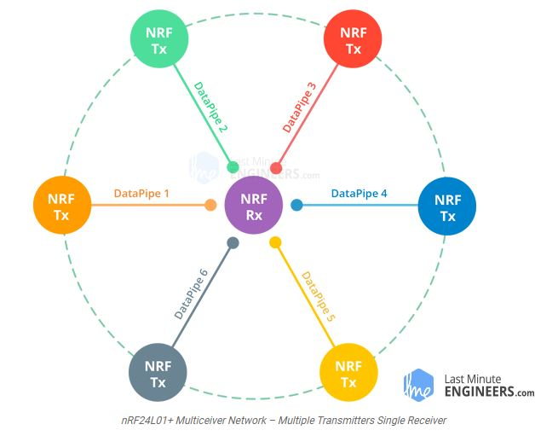
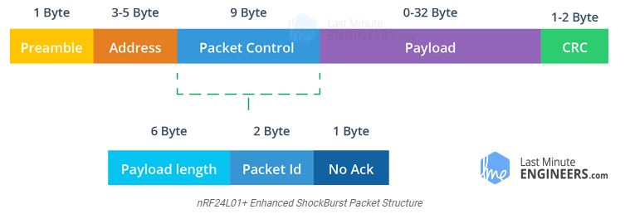
nRF24L01+ Multiceiver Network:
RF channel is logically divided into
6 parallel data channels called Data Pipes.
Each data pipe has its own physical
address (Data Pipe Address).
Enhanced ShockBurst Protocol:

Slide 13
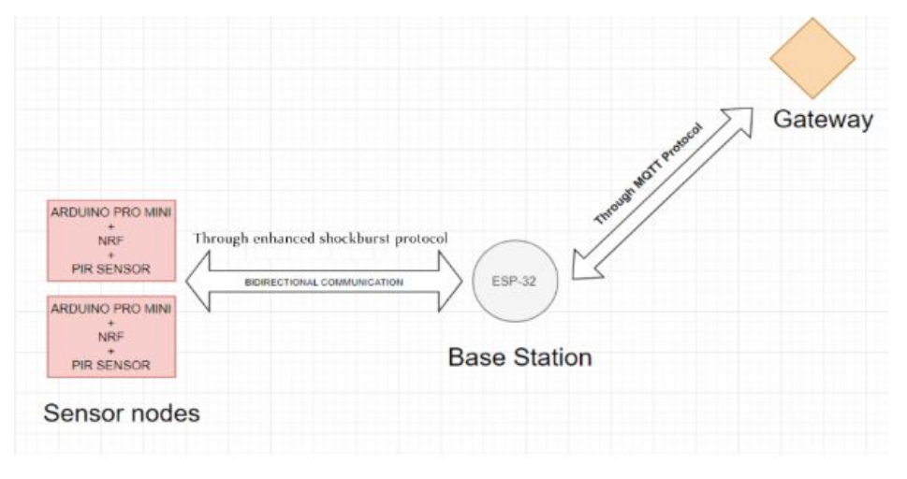
Architecture:

Slide 14
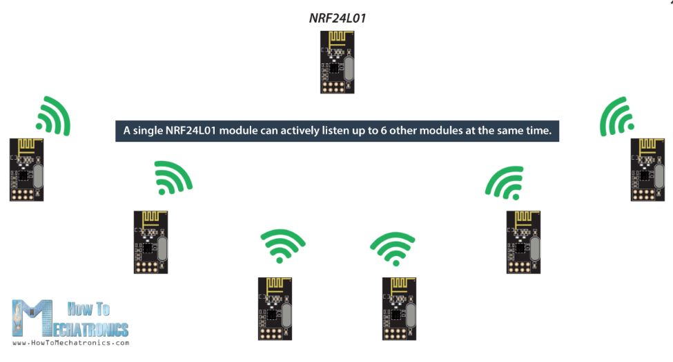
Communication using NRF protocol:
Two ways to communicate:
1. Using nRF24L01 library: (Difficult to implement)
2. Using RF24Network library: Enables in an easy way to build a wireless network with many Arduino boards communicating to each other

Slide 15

Steps:
Define libraries and adresses for each node and also SPI pins.
Setup all the parameters.
Update network everytime.
Read the motion using motion sensor.

Slide 16
Send data when motion is detected at the same time.
Listens if any data is incoming to that node.
Note :
When using multiple nodes communicating to one node , same process is followed and each data has to be identified that from which node it is coming.

Slide 17
Base station(esp32) to gateway:
1.Sent using Wifi module
2.Using MQTT protocol

Slide 18
MQTT Protocol:
Publish Subscribe Model for iot projects
Why not HTTP?(Request response model)
-Simple
-Consumes less power then HTTP
-Lesser Network Overhead(Smaller payload)
-Designed for QoS
If set 0,works like udp.No reliability.
If set 1,we will be noified whether delivered or not?(by PAYBACK header)

Slide 19
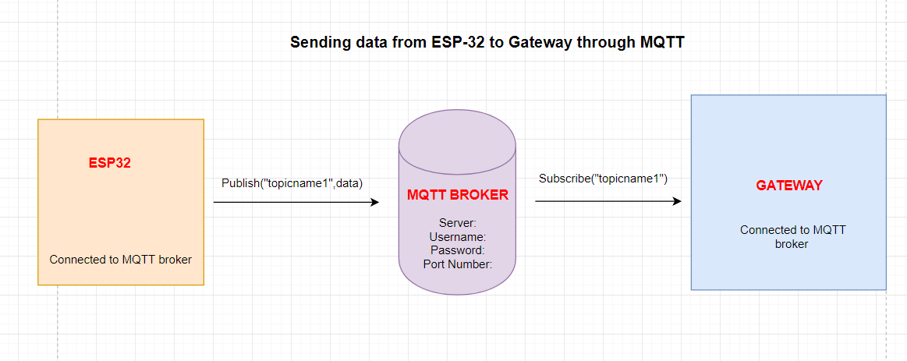

Slide 20
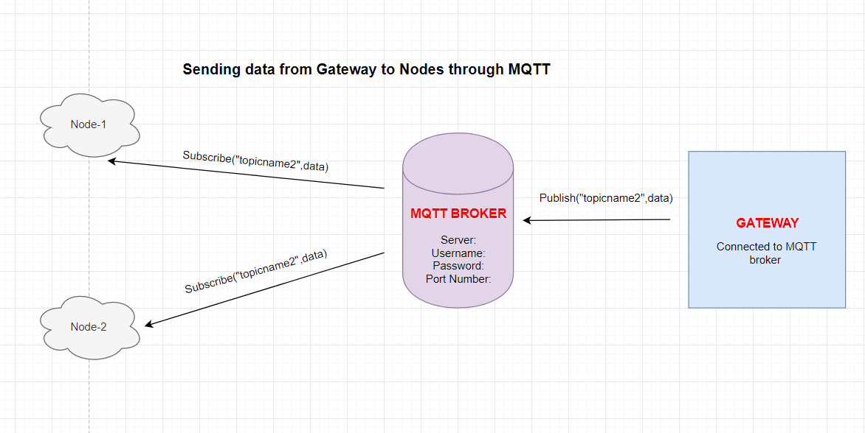

Slide 21
Understanding the code:
The PubSubClient library enables a client for doing simple publish/subscribe messaging with a server that supports MQTT (basically allows your ESP32 to talk with Node-RED)
-Connecting to the same wifi network:
-Setting the broker details:
char server[] = "172.18.22.9"
int port = 1886;
const char* mqttUser = "yourMQTTuser";
const char* mqttPassword = "yourMQTTpassword";

Slide 22
Understanding the code:
-Checking whether the client is connected or not?
!client.connected()
It returns a bool value
-If not connected:
use reconnect() with delay of every 5 s

Slide 23
Understanding the Code:
-Publishing on a topic:
client.publish("esp32/temperature", tempString);
-Subscribing on a topic:
client.subscribe("esp32/output");

Slide 24
Relating Code with Workflow:

Slide 25
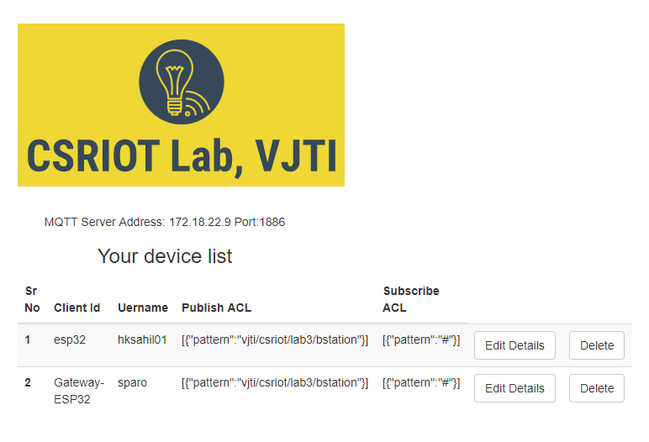
Simulating devices:

Slide 26
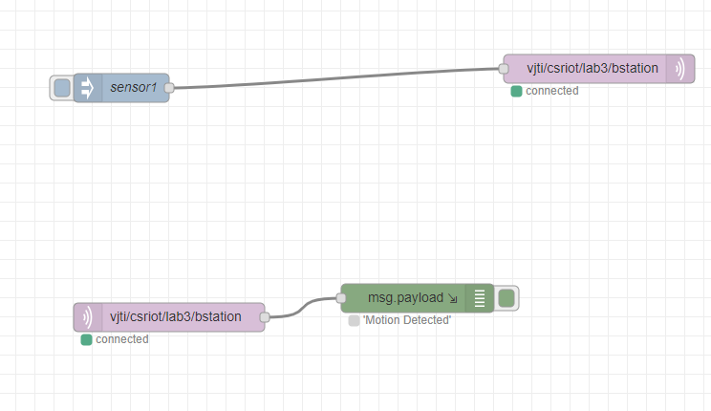
Our Node-RED Workflow:

Slide 27

Output:

